Slide 1

TOPLANTZ WELLBEING WEBSITE
Combining plants and wellness to bring beauty, hope and healing into your home

Slide 2

INTRODUCTION
ABOUT US
01
04
WIREFRAME
TABLE OF CONTENTS
02
HOMEPAGE
03
Our ideas for a website
An outline of our ideas and objectives
INFORMATION PAGES
Using Balsamiq to arrange and design our webpages and how they will interact
Information about the best plants to arrange in your home and where to buy them
05
REGISTRATION FORM
How our homepage was created to introduce our website to all web users
A registration form to capture details about someone interested in our site; use of JavaScript
06

Slide 3
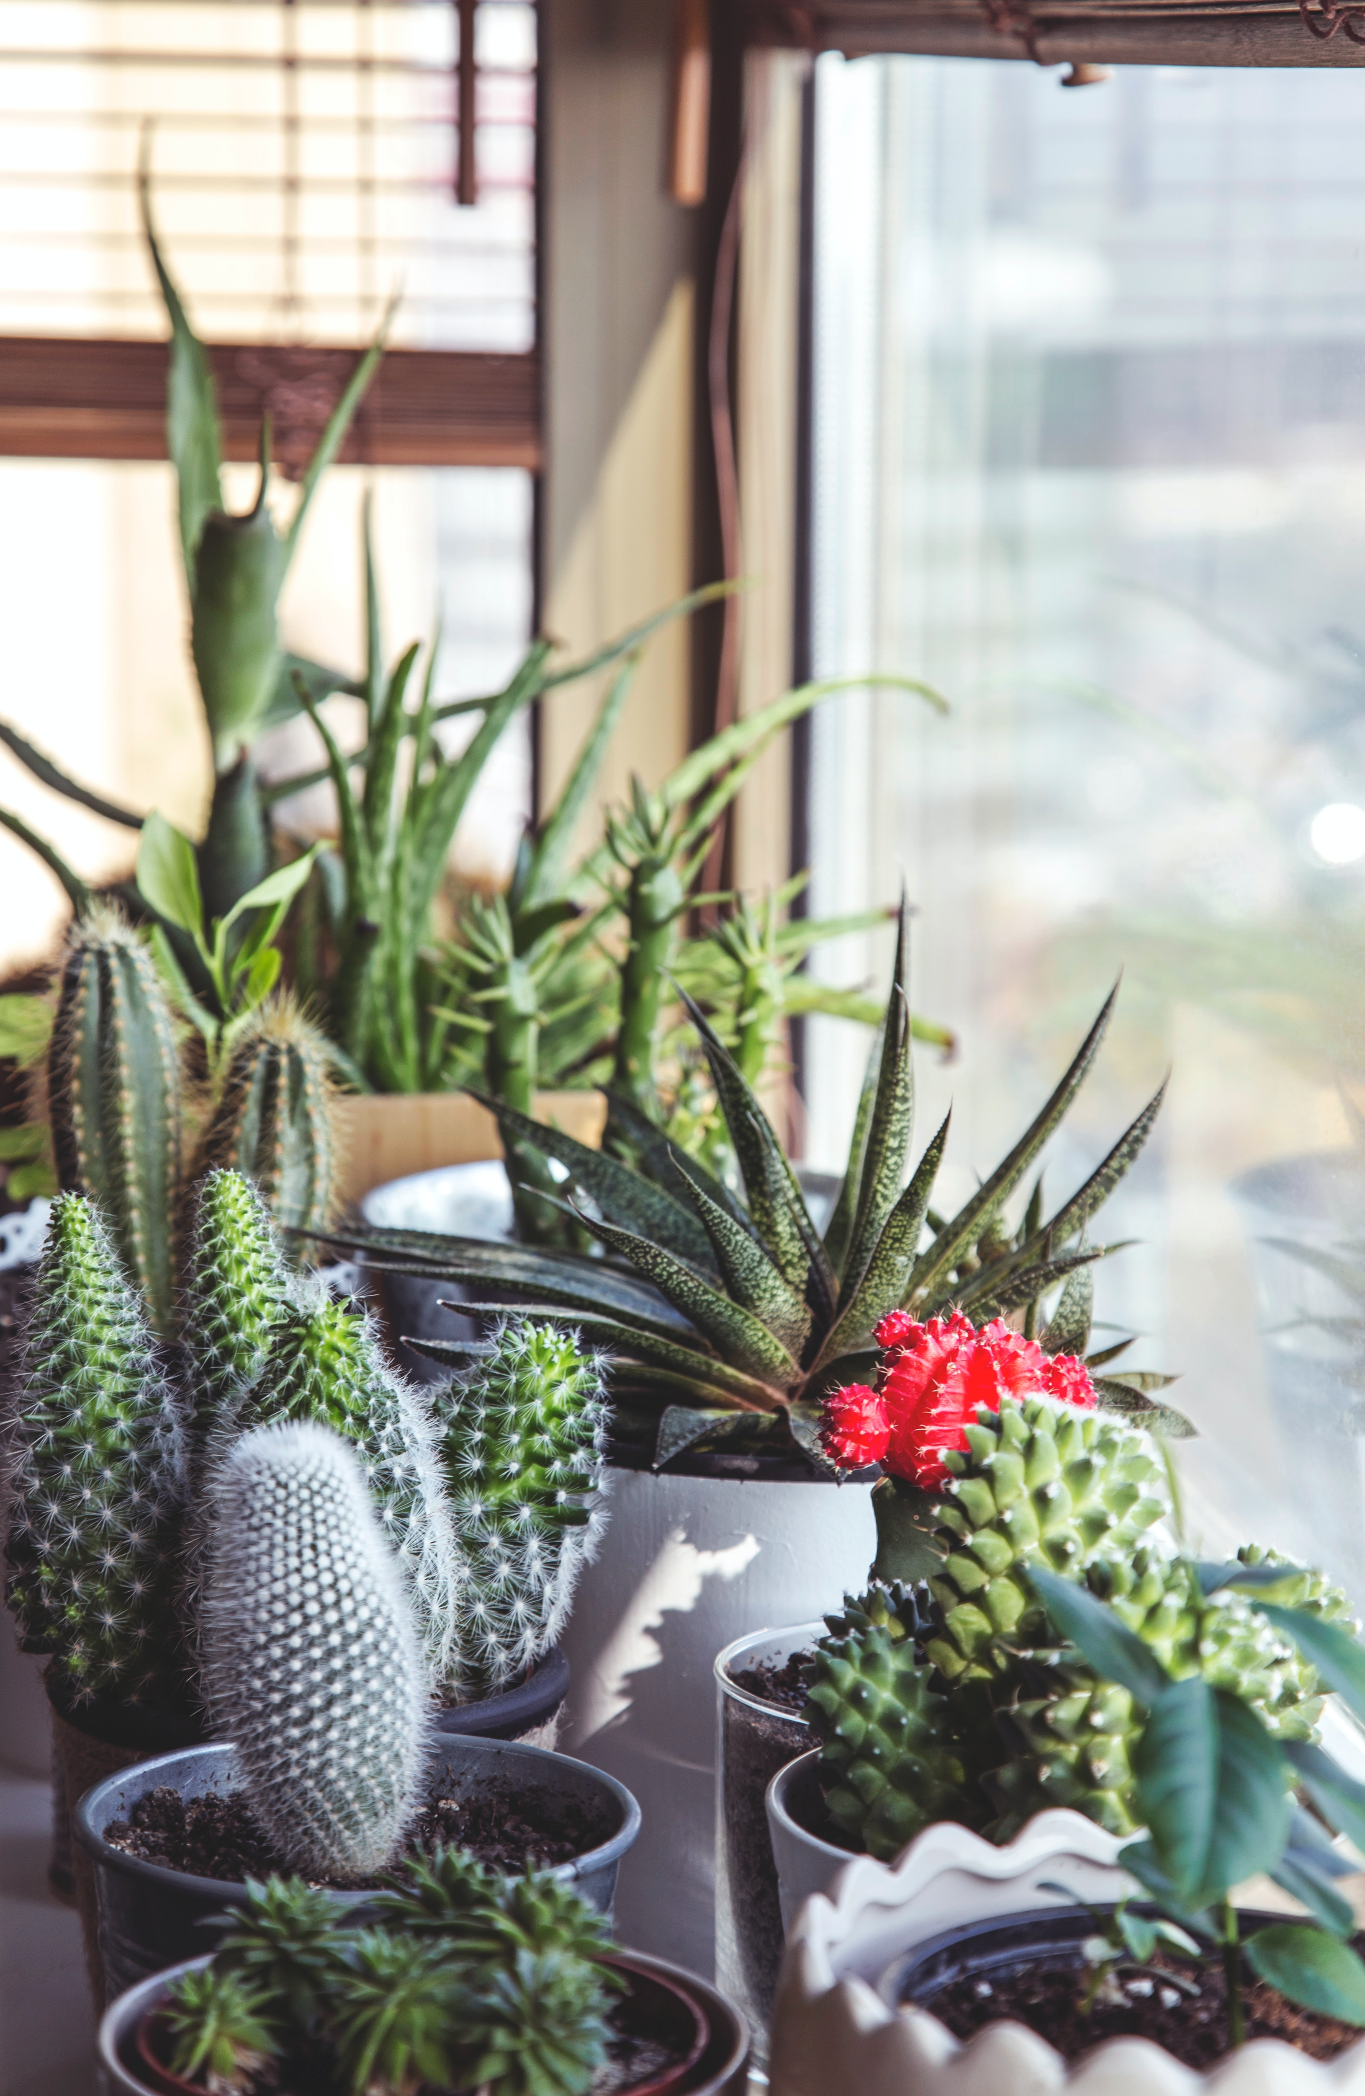
INTRODUCTION
INTRODUCTION
As a group, we decided to create a website that combines plants and wellness to bring beauty and healing into your home.
Our website would include a Homepage, About us page, Information pages about the plants we recommend in your home, and a registration form.
We planned to combine HTML, CSS and little bit of JavaScript to make our pages interactive and responsive.
We distributed each webpage between our 4 group members and combined the code at the end in GitHub to create our final product.
We shared fonts, colour schemes and ideas in Slack to ensure our design was consistent.

Slide 4
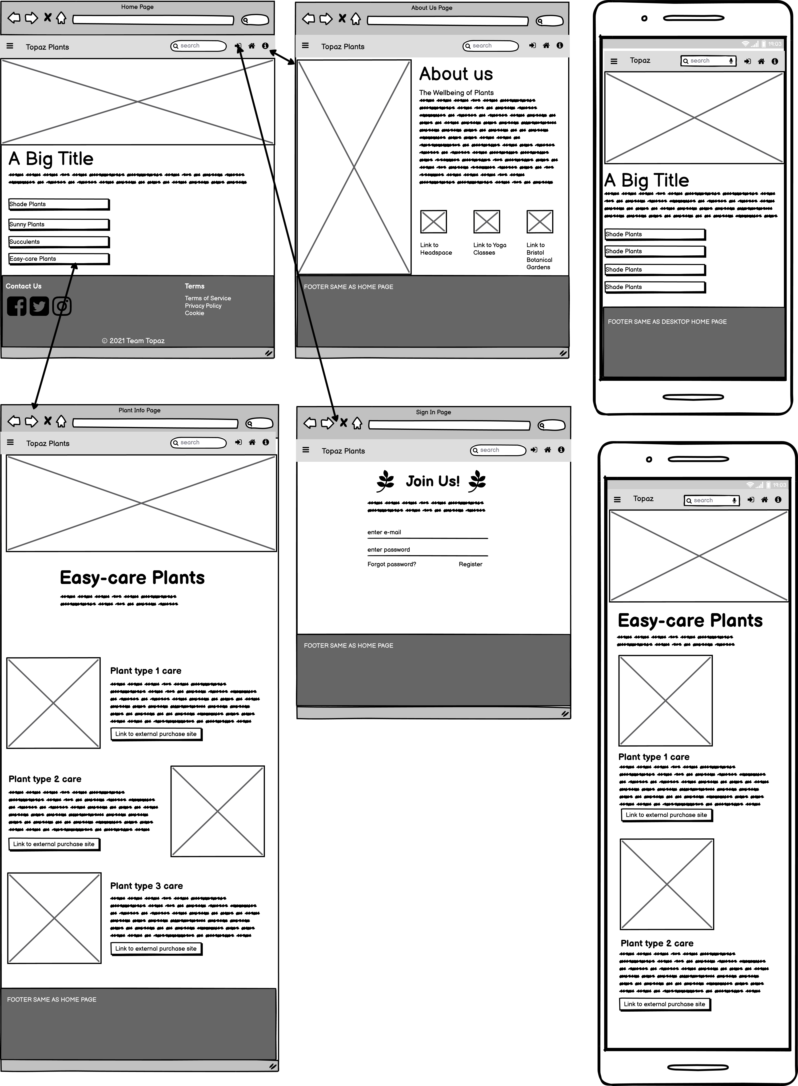
WIREFRAME
WIREFRAME
We used the software Balsamiq to visualise our website.

Slide 5
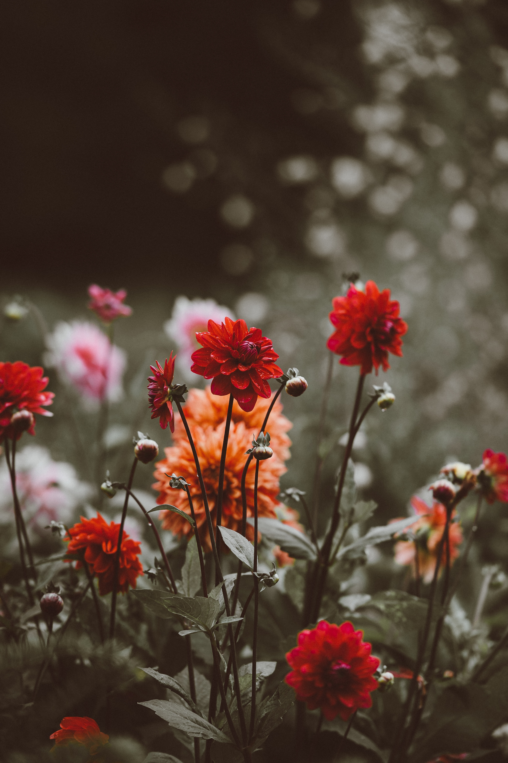
HOMEPAGE
HOMEPAGE
By Miah Bates
The wireframe was used to create a Homepage that introduced the rest of the site.
From the homepage, all other pages on the website could be accessed; the “About us” and “Registration” pages were accessed through the navbar, and the plant information pages were linked in the main content.
Use of HTML and CSS to create the design.
Javascript used on the navbar.

Slide 6
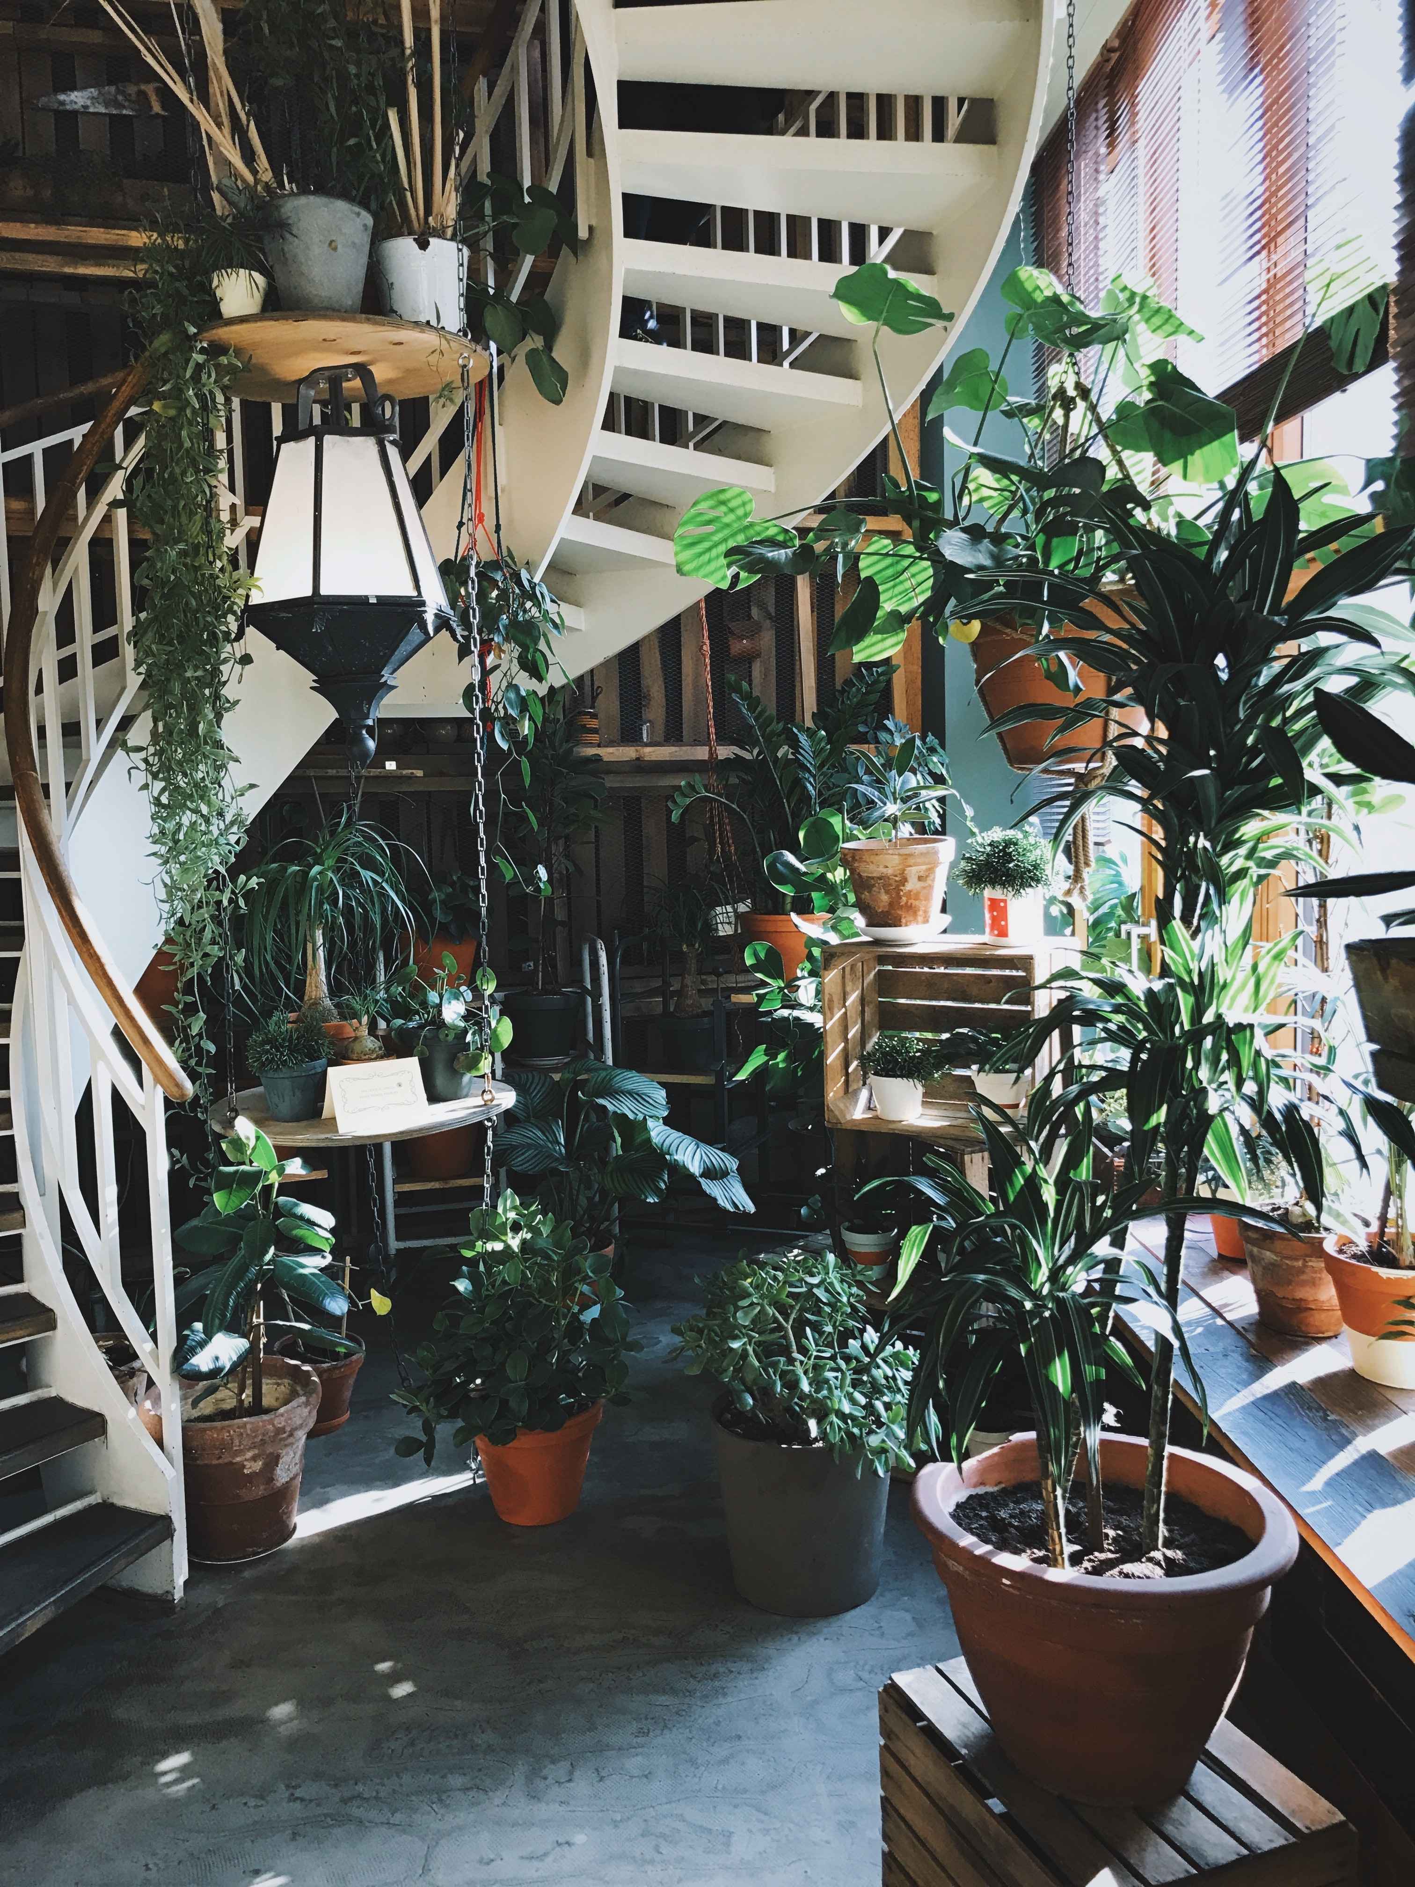
ABOUT US
ABOUT US
by Konstantina Diamanti
From the navbar on all pages, the information symbol redirects users to the “About us” page.
This page was designed to explain our group ethos.
Use of HTML and CSS to design the webpage.
Link to Homepage, About us and registration from from the navbar.

Slide 7

PLANT INFORMATION PAGES
PLANT INFO
PAGES
By Terri Lowe
From the Homepage, web users can choose from one of four plant types that suit their home; Easy-care plants, sun-loving plants, shade plants or succulents.
Once they click the link, they are taken to that webpage which explains which plants fit best into that group and how to properly take care of them.
There is also a link to external webpages to show where these plants can be purchased.
HTML and CSS were used to design the page; use of flexbox and imported fonts.

Slide 8
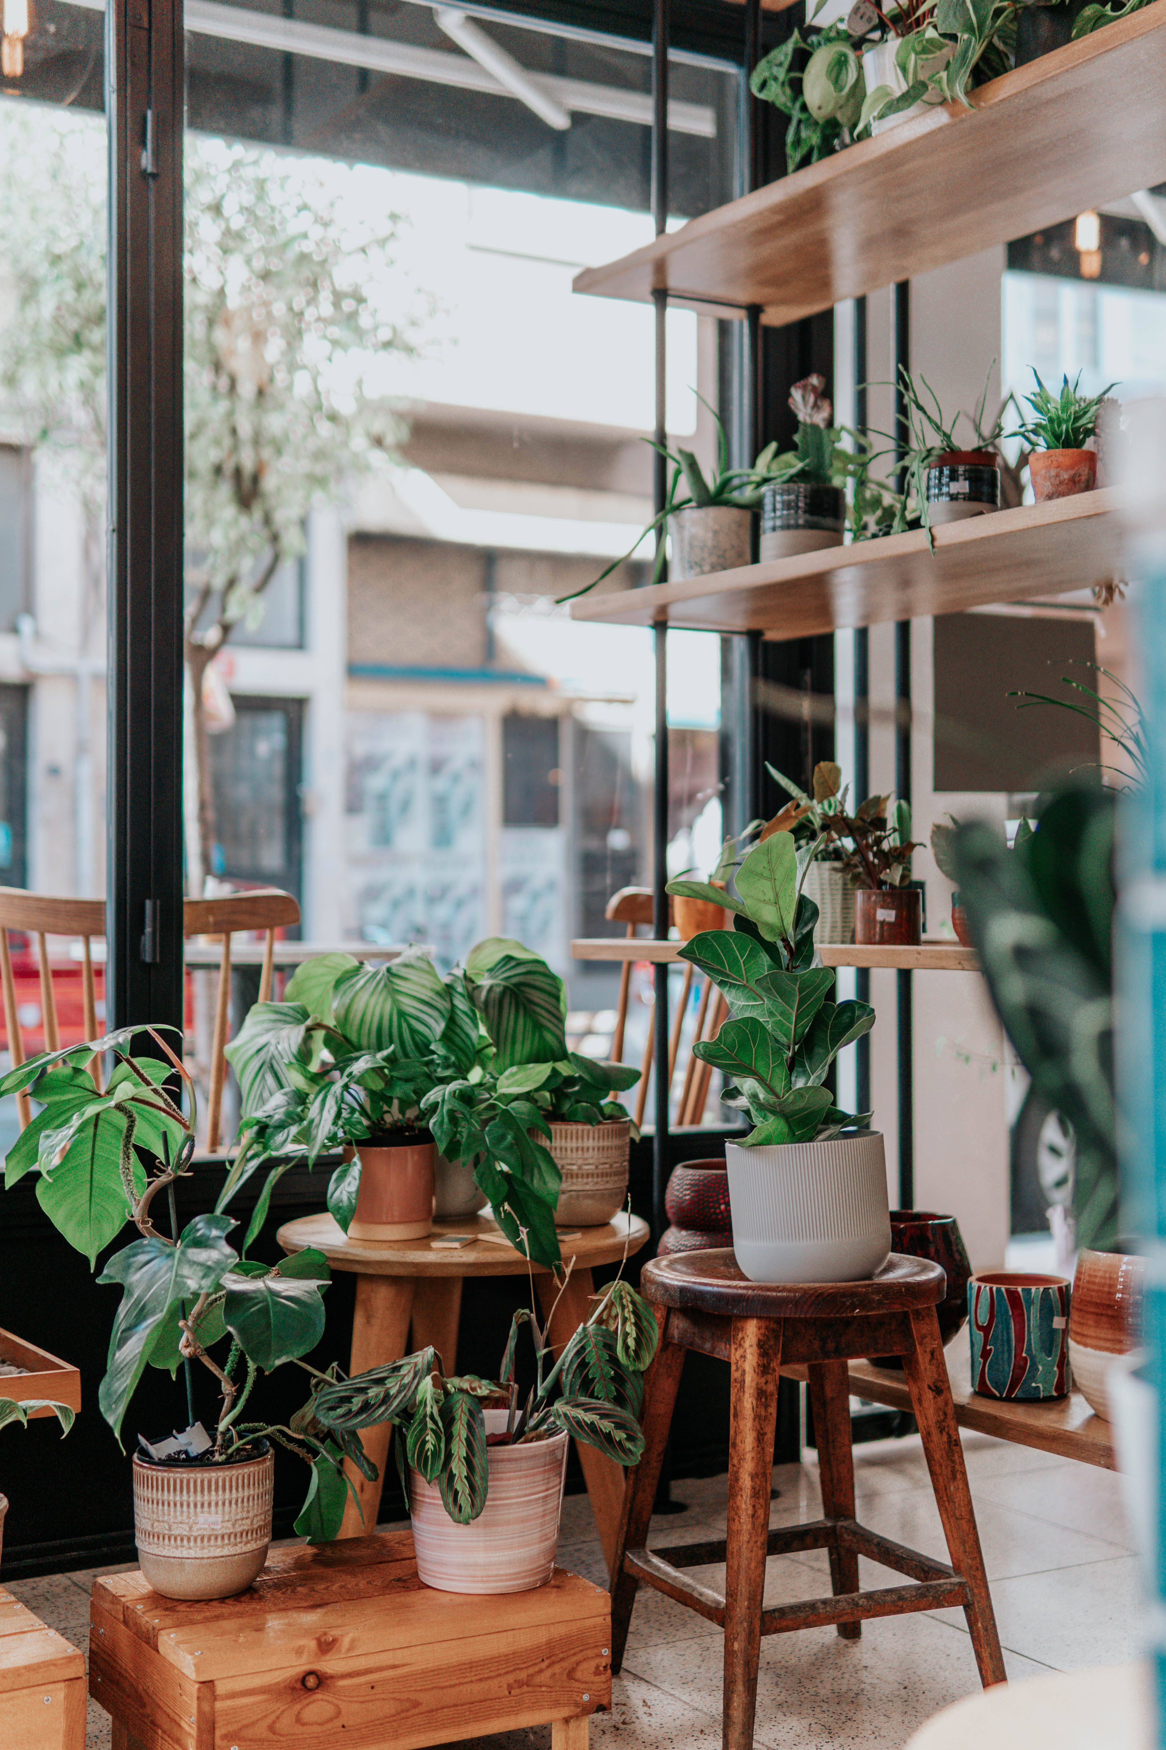
REGISTRATION FORM
REGISTRATION
FORM
By Fadumo Jama Abdi
From the navbar on all pages, the registration button redirects users to the registration form where they can input their details for signup.
Use of JavaScript to create the form and capture the data.
Navbar to redirect to the Homepage and About us page.

Slide 9
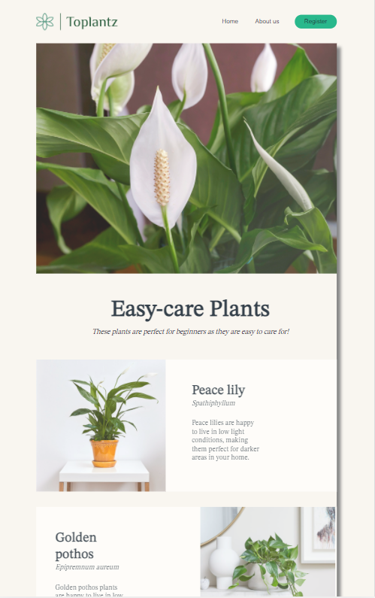
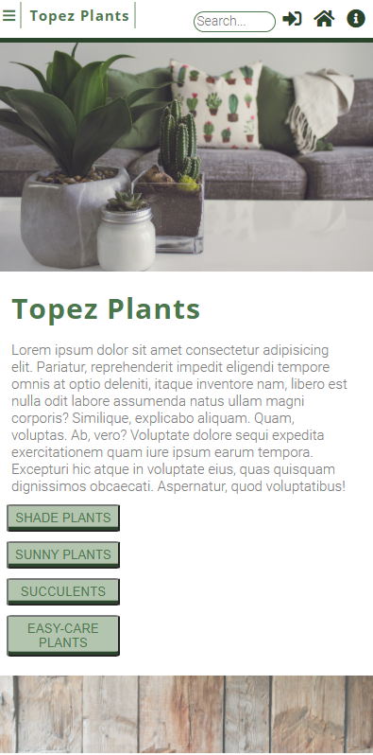
RESPONSIVENESS
@media only screen and (min-width: 320px)
@media only screen and (min-width: 768px)
We all used the @media CSS at-rule to create a responsive website that could be displayed on different media types including mobile phones (320px), iPads (768px) and desktop computers (980px+).
@media only screen and (min-width: 980px)
@media only screen and (min-width: 1500px)

Slide 10

THANK YOU
Does anyone have any questions?

Slide 11
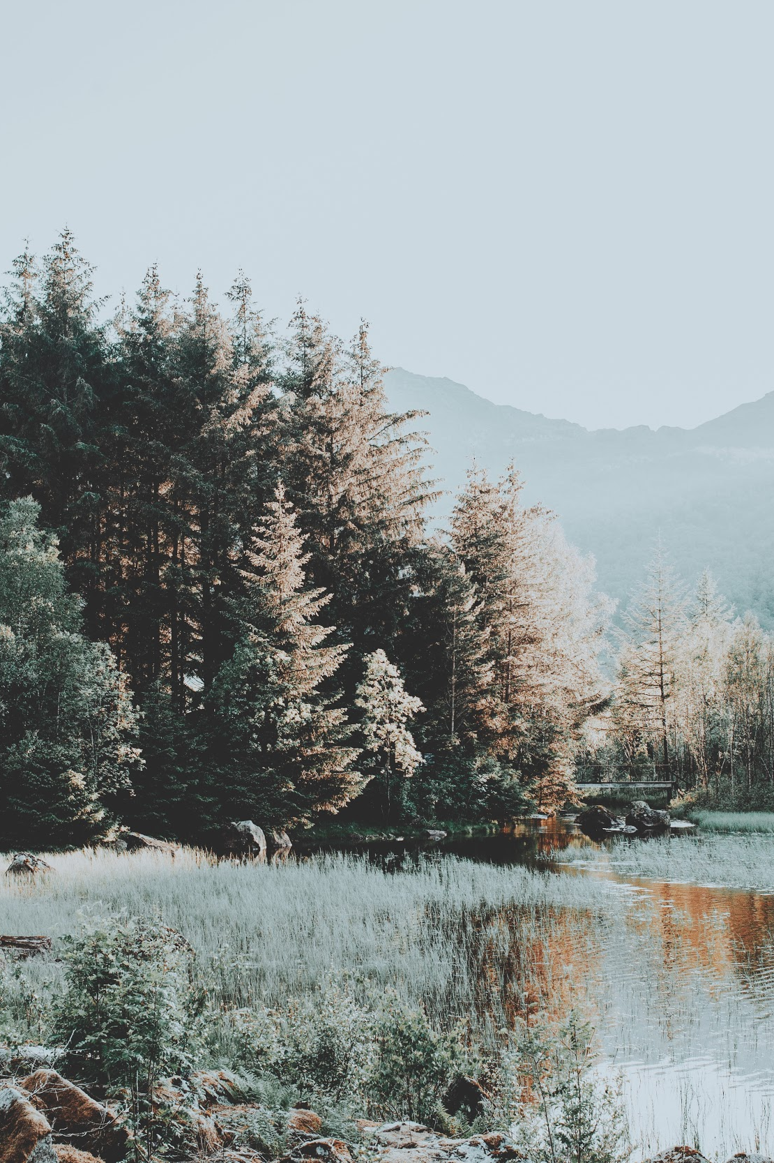
CREDITS
Presentation template by Slidesgo
Icons by Flaticon
Wireframe by Balsamiq
Webpages combined in GitHub
Images created by Freepik & Unsplash
Website created by Miah Bates, Terri Lowe, Konstantina Diamanti & Fadumo Jama Abdi

